Slide 1




William Rhodes Primary and Nursery School
British Values Statement 2025- 26
At William Rhodes Primary and Nursery School, we aim to give our children the knowledge and understanding they need, in order to become global citizens of tomorrow. We teach them key messages in order for them to understand how to keep themselves and others safe and how to show kindness, empathy and understanding to others and celebrate our differences as they are what make all of us unique!
The British Values form a large part of our every day school life and are taught through our daily assemblies and our wider curriculum. Here are the ways in which the values are brought to life in our school:
Children are given a voice through pupil voice groups across school, including our Pupil Parliament and Reading Ambassadors who help to shape the school curriculum, policies and procedures.
Teachers ask children for their thoughts and opinions and these are used, wherever appropriate to influence decision making.
Restorative conversations happen regularly in school, which help children to understand situations, accept responsibility, empathise with others and suggest ways in which to move forwards.
Children are taught about democracy and how things are made fair, with the understanding that fair is not always equal.
Parent views are sought regularly, through Parent Surveys and feedback is taken on board and, where appropriate, acted upon.

Slide 2
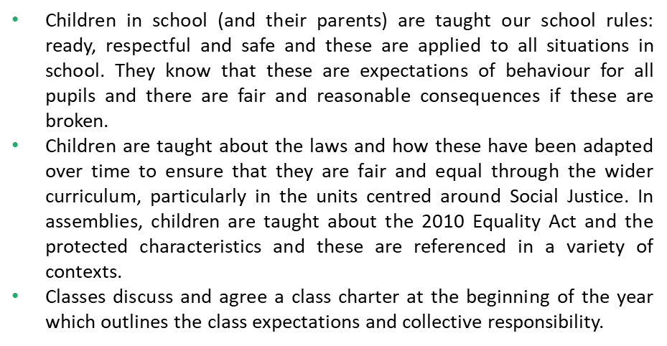




Children are taught that they are valued for their individuality and are safe to be themselves within our school.
Children are given opportunities to make choices and respect the choices of others.
Children are taught about significant events in history, which have led to a more inclusive society throughout the curriculum. They understand the importance of individual liberty.
Children are taught to celebrate individuality and to be excited about having the opportunity to learn about others.
Literature is available to children throughout school, which celebrates diversity and individuality.
It is our aim that all children feel represented through our curriculum.
All staff model respect to each other, families and children.
Respect is one of our school rules and is taught explicitly: it is an expectation of all pupils to show respect to others.
Respect comes from understanding, so our curriculum is carefully planned to ensure that children are taught about a range of people, races and beliefs and that these are celebrated.
We are a ‘No Outsiders’ school and we promote the message that everyone is welcome: we value and celebrate differences.

